Slide 1
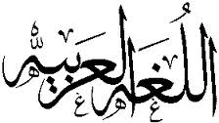
Welcome to Arabic Level I by Kurzban

Slide 2
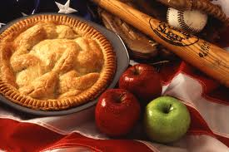
Lesson 4: الدرس الرابع
فطيرة التفاح
تفاح
سكر
زبدة
فطيرة قمة

Slide 3
Lesson 4: الدرس الرابع vowels part II
Objectives:
Quiz corrections and feed back
Identify long and Short Vowels
Practice
Summary
Flash card
Study for Quiz 2 at the end of the week!

Slide 4
Lesson 4: Identifying short vowels
Remember that Short vowels are written above and below the letters.
Short vowels appear only in pronunciation but do not have letters that represent them in writing. As previously discussed, the short vowels are represented by : a , i , and u .
Fatha, kasra and damma

Slide 5
Lesson 4: Identifying short vowels
In addition to Fatha, kasra and damma, if there is a small circle above the letter sukoon, ( ) this means {stillness}
It indicate that no vowel sound follows that letter such as {Stay & drag}

Slide 6
Working with Sukoon
بَ + يْ + ت =
تِبْن =
بَ + يْ + نَ =
بِ + نْ + ت =

Slide 7
Working with Shadda
In addition to the three short vowels and the sukoon, there is another symbole: the Shadda. This is a small w shape ( ) written above the letter to show that is doubled.
بُ + ن + ن = بُنّ
بَ + ث + ث = بَثّ
The sound of a letter is lengthened when there is a shadda.

Slide 8
Identifying long vowels
The three long vowels will be Represented as: aa , ee , oo .
Baa Bee Boo
بو بي با

Slide 9
Identifying long vowels
Long vowels are denoted in writing with the letters: و ، ي ، ا respectively.
But we already know that these three letters are the three consonants: ' , y, w .
Therefore, these three letters can denote both the consonants and long vowels. This is why they are called the "weak letters" حُرُوْفُ الْعِلَّةِ .

Slide 10
Mini practice
Practice saying these letters with their vowels.
1] بَا 3] تِي
2] ثُو 4] زِي

Slide 11
Mini practice
Practice saying these letters with their vowels.
1] بْ 3] دْ
2] نِّ 4] يَّ
Notice that kasra is often written under shadda rather than below the letter.

Slide 12
Lomg Vowels continue
ب ت ث ن ي
Use long vowel {alif} for all above letters
ب ت ث ن ي
Use long vowel {waw} for all above letters
ب ت ث ن ي
Use long vowel {ya} for all above letters

Slide 13
Summary
Examine these words and identify the vowels that we have discussed by circling them and list their names
حِدادْ
ضَرْبِ
عُشْبُ
تَدَحْرَجَ
حَجَّ
خِطاب

Slide 14
Homework: Name: Arabic Alphabet: Connecting them
ثَ +ب + ب +تَ=
ب + يْ +نَ =
=يَ + بُ + ثُ +ث
ب + يْ+ت =

Slide 15
Build your Vocabulary
A girl in Arabic is:?

Slide 16
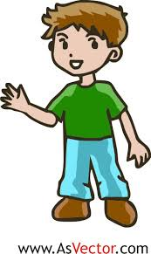
Build your Vocabulary
A boy/son in Arabic is:?

Slide 17
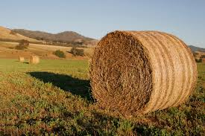
Build your Vocabulary
A hay in Arabic is:?

Slide 18
Vocab: Continue
Name this:

Slide 19
Be ready for your next quiz
Study all materials covered in lesson 1, lesson 2 and lesson 3
Practice your hand writing, you will be graded on it as well.
Know your one and two way connectors.

